Slide 1








Actionable Insights
and their Implementation Roadmap
S
Presented by
Sneha Mishra

Slide 2






1
2
3
4
5
6
Vary the Average Daily Rate
Top Choice for Last Minute
Targeted Incentives
Diversify Market Segments
Reduce long wait times
Find & Fix issues with Room Type A
Insights Derived
2

Slide 3
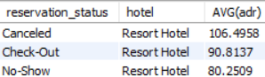
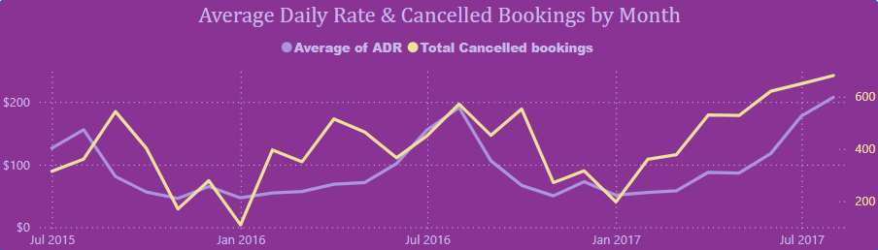
Vary the Average Daily Rate
In Resort hotels, the cancellation booking trend aligns closely with the average daily rate curve.
Notably, the average price of a cancelled room is 17.3% higher than that of a room that remains booked. This indicates that to reduce cancellations, we should consider lowering prices.
3

Slide 4
1
2
3
4
5
6
Vary the Average Daily Rate
Top Choice for Last Minute
Targeted Incentives
Diversify Market Segments
Reduce long wait times
Find & Fix issues with Room Type A
Insights Derived
4

Slide 5
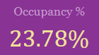
Top Choice for the Last Minute
For Resort Hotels, given our current occupancy rate of just 23.78%, we have a prime opportunity to position our hotel as the go-to choice for last-minute bookings, especially considering our tourist-friendly locations.
By partnering with local businesses such as travel agencies, event organizers, and transportation services, we can effectively promote our hotel to spontaneous travelers.
This strategy will help fill rooms that would otherwise remain vacant, significantly boosting our occupancy rate.
5

Slide 6
1
2
3
4
5
6
Vary the Average Daily Rate
Top Choice for Last Minute
Targeted Incentives
Diversify Market Segments
Reduce long wait times
Find & Fix issues with Room Type A
Insights Derived
6

Slide 7
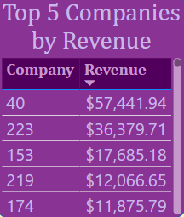
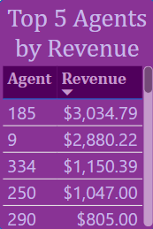
Targeted Incentives
Rewarding our top companies & agents with coupons/offers on dine in & other in house services, could stimulate further bookings & could help in establishing mutually beneficial partnerships
7

Slide 8
1
2
3
4
5
6
Vary the Average Daily Rate
Top Choice for Last Minute
Targeted Incentives
Diversify Market Segments
Reduce long wait times
Find & Fix issues with Room Type A
Insights Derived
8

Slide 9
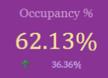
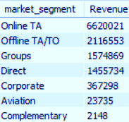
Diversify Market Segments
With agents driving 72 % of the revenue, it is imperative that we start diversifying our customer base into different segments
The Occupancy rate of 62%, is below the industry standard of 75%-85%.
Having special discounts or perks for customers booking directly with us, would both, boost bookings & lead to an increase in occupancy rates.
Creating packages tailored specifically for corporates & groups, as they are our 3rd & 5th largest clientele respectively
9

Slide 10
1
2
3
4
5
6
Vary the Average Daily Rate
Top Choice for Last Minute
Targeted Incentives
Diversify Market Segments
Reduce long wait times
Find & Fix issues with Room Type A
Insights Derived
10

Slide 11
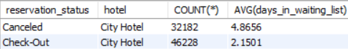
Reduce the Long Wait Times
In city hotels, cancelled reservations tend to remain on waiting lists much longer than those that are not cancelled. On average, they spend about 2.3 times more time waiting.
To reduce these extended wait times, we need to streamline booking processes, to avoid such long waits & subsequent loss of revenue
We should incorporate algorithms to more precisely predict demand and occupancy, cutting wait times.
11

Slide 12
1
2
3
4
5
6
Vary the Average Daily Rate
Top Choice for Last Minute
Targeted Incentives
Diversify Market Segments
Reduce long wait times
Find & Fix issues with Room Type A
Insights Derived
12

Slide 13
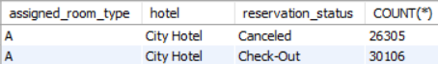
Find & Fix issues w/ Room Type A
At City Hotel, Room Type A has an exceptionally high cancellation rate of 87.4%. Out of the 30K bookings made, over 26K were cancelled.
A thorough examination must be done to understand what about room type A makes it the most cancelled - is it overpriced, underwhelming or are there better alternatives that customers are switching to?
13

Slide 14
Implementation Roadmap
Short Term
Mid Term
Long Term
Software Development
Vary the average daily rate
Targeted Incentives to Top revenue drivers
Reduce wait lines & streamline booking
Marketing and Offers
Diversifying the customer segments
Top Choice for Last Minute Bookings
Management
Find & Fix the issues with Room Type A
14

Slide 15
Thank you for Viewing
15

